Slide 1

Module 1
Regression Basics
Notes:
Guidelines
Use section headers to chunk content in your presentation.
Use the same style of section header throughout your presentation.
Keep your title to no more than 2 lines.

Slide 2
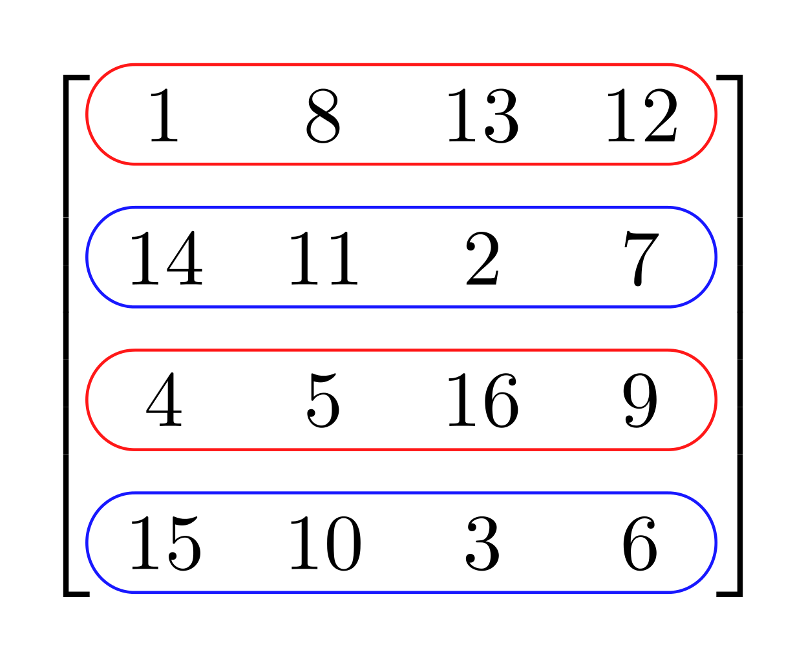
Regression Matrix Formulation
Notes:
Guidelines
Use a title slide at the beginning of your presentation. There are 9 variations of title slides to choose from.
If you will have a series of slideshows, we recommend using the same style of title slide for each presentation.
Keep your title to no more than 2 lines.
Do not change the font style or font size of the title or subtitle.

Slide 3
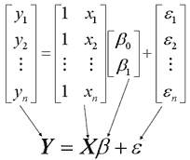
Regression With Matrices
Regression can be formulated with matrices
Makes it easier when using multiple predictors

Slide 4
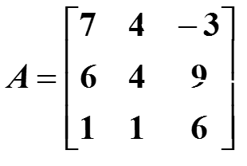
Matrices
Rectangular arrays of numbers (called elements)
Dimensions represents the number of rows and columns in array
Columns
R
O
W
S
A has dimension 3 x 3 (3 rows by 3 columns)

Slide 5
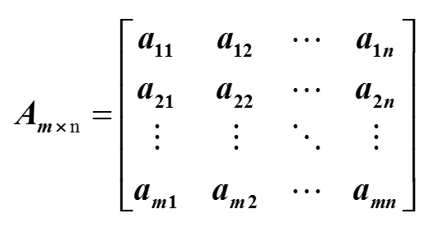

Matrix Dimensions
The matrix below is a generic matrix of size $m×n$
a_{ij} = the number in the i^{th} row and the j^{th} column

Slide 6
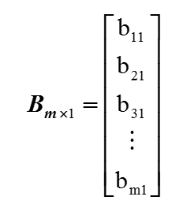


Vectors
A matrix with 1 column ($m×1$) is called a column vector
A matrix with 1 row ($1×m$) is called a row vector

Slide 7
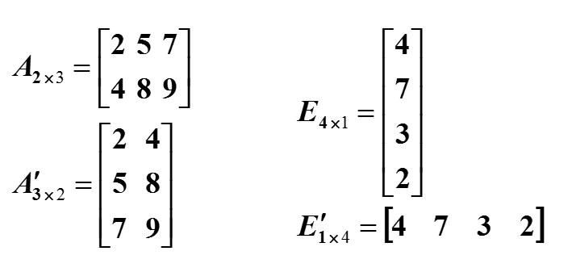
Transpose
Interchanges the rows by the columns

Slide 8
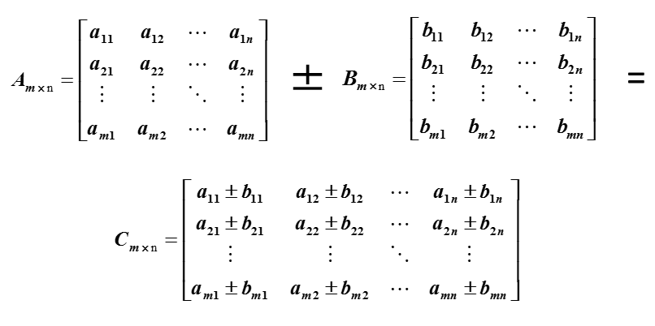
Matrix addition/subtraction
Must be same dimensions

Slide 9
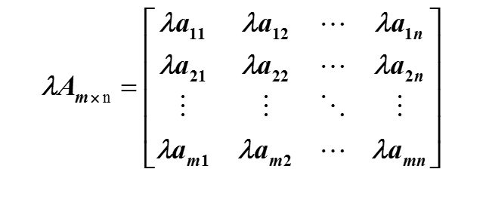
Scalar Matrix Multiplication
Multiply each element by scalar

Slide 10
Multiplying a Two Matrices (A and B)
Columns of A must equal rows of B
Resulting matrix is of dimensions rows of A, cols of B
A₂ _{x} ₃ * B ₃ _{x} ₂ can be calculated. Result is C ₂ _{x} ₂
A₃ _{x} ₃ * B ₃ _{x} ₂ can be calculated. Result is C ₃ _{x} ₂
A₃ _{x} ₂ * B ₄ _{x} ₂ cannot be calculated.
A₃ _{x} ₂ * B ₂ _{x} ₇ can be calculated. Result is C ₃ _{x} ₇
A₁ _{x} ₂ * B ₂ _{x} ₁₂ can be calculated. Result is C ₁ _{x} ₁₂

Slide 11
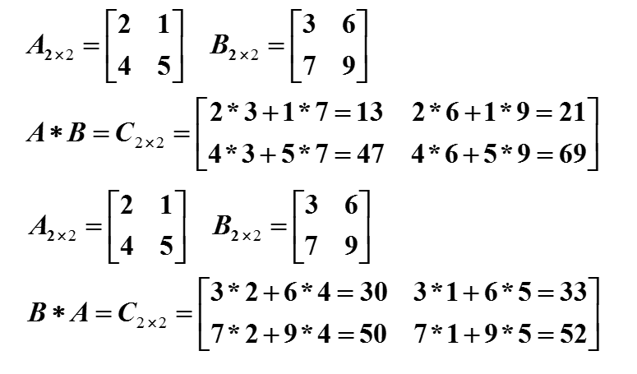
Multiplying a Two Matrices (A and B)
Example

Slide 12
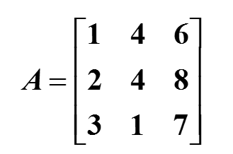
Linear Independence
A matrix is linearly independent if there is no linear combination in it columns (or rows)
The rank is the number of independent columns.
The determinant of a linearly dependent matrix is 0.
Column 3 equals 2 times column 1 + column 2
A is NOT linearly independent
Rank of A is 2

Slide 13
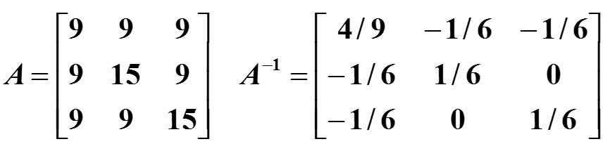
Inverse of a Matrix
If a matrix is square (rows = cols), the inverse of a matrix A is the matrix A⁻¹ such that AA⁻¹ = A⁻¹A = I.
A⁻¹ only exists if A is independent.

Slide 14
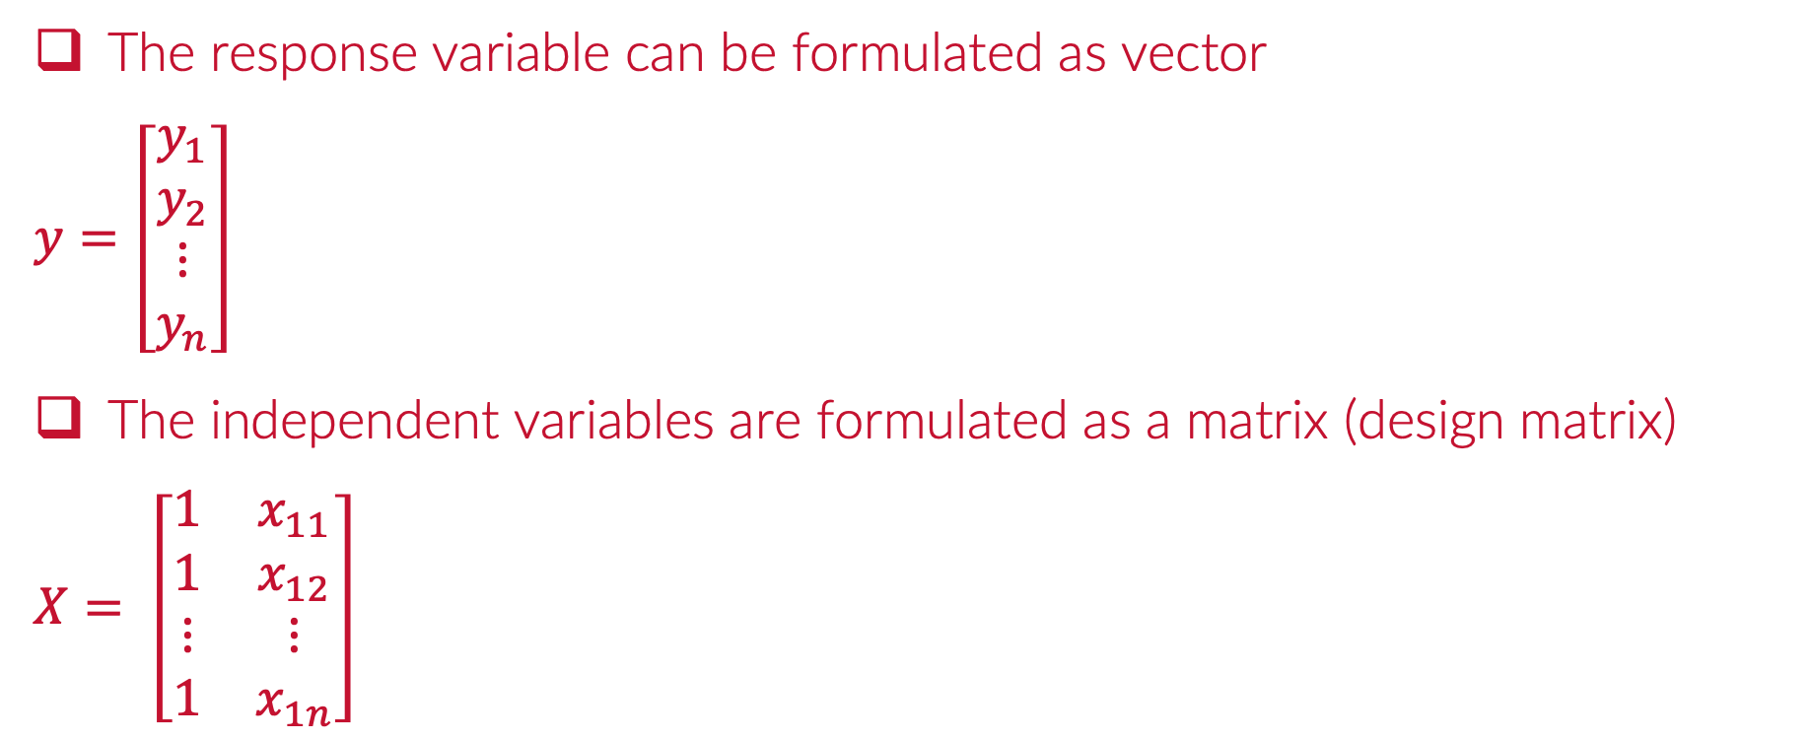
Matrix Formulation of Linear Regression
The response variable can be formulated as vector
$$y=\left[\begin{matrix}y_{1} \\ y_{2} \\ ⋮ \\ y_{n}\end{matrix}\right]$$
The independent variables are formulated as a matrix (design matrix)
$$X= \left[\begin{matrix}1 & x_{11} \\ 1 & x_{12} \\ ⋮ & ⋮ \\ 1 & x_{1n}\end{matrix}\right]$$

Slide 15

Matrix Formulation of Linear Regression
The estimates are obtained by:
$$\hat{β}={\left(X^{⊤}X\right)}^{−1}(X^{⊤}y)$$

Slide 16
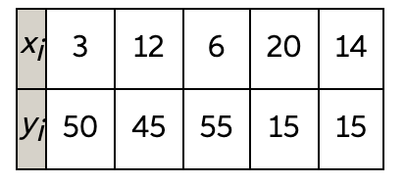
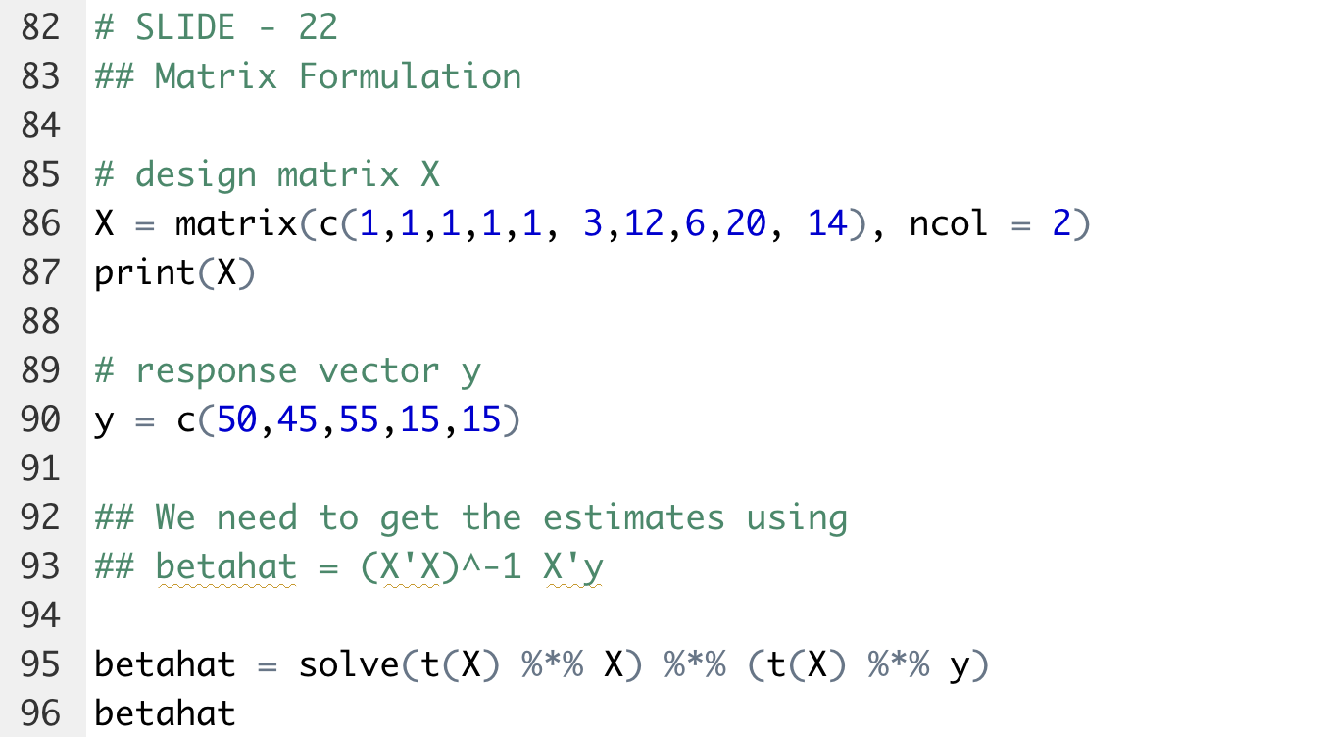

Matrix Formulation Example (scratch)
Suppose we have the data:

Slide 17
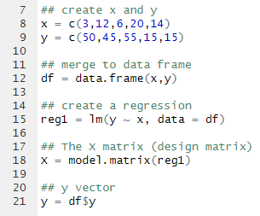
Matrix Formulation Example (fit)
Instead of creating the X matrix and y vector from scratch, we can retrieve from regression object if needed.

Slide 18

Practice

